Slide 1



Premium Fib Class
“The Best Way To Trade With Fibonacci Ratio Analysis”
1.618
Today we will learn how to combine Fibonacci
Ratio Analysis with EW for trading entries and exits.
We will begin at 8 PM ET – You will hear no sound until we start

Slide 2
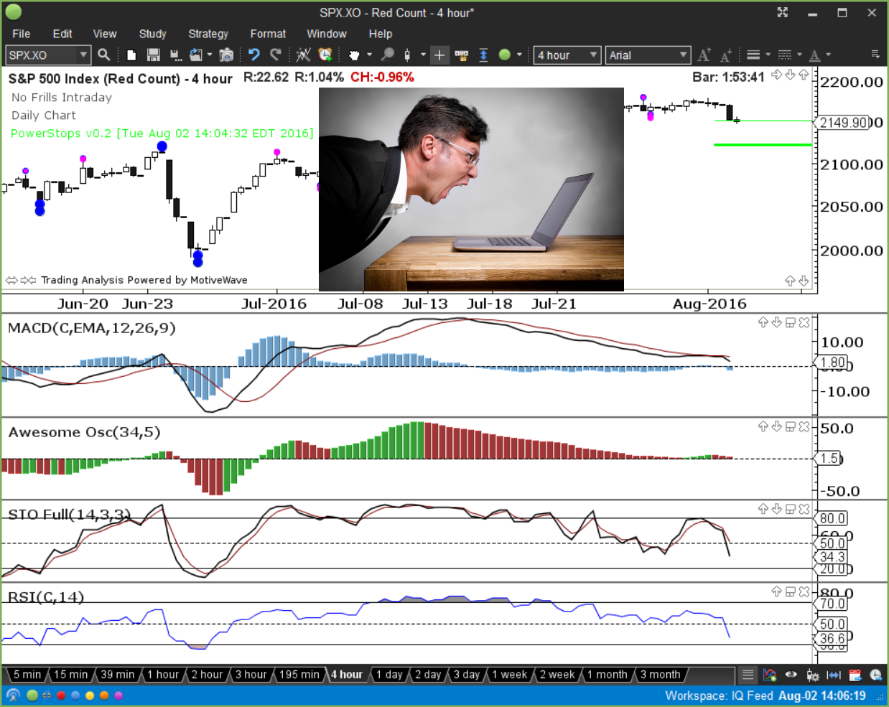
Have you gone through the indicator evolution?
Have you reached the point of indicator paralysis by analysis?

Slide 3
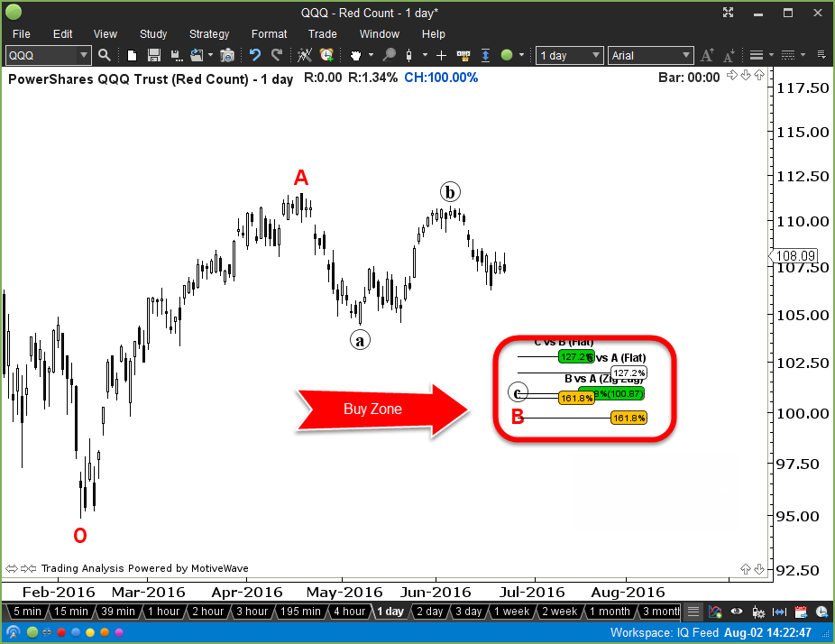
Minimum Effective Dose

Slide 4
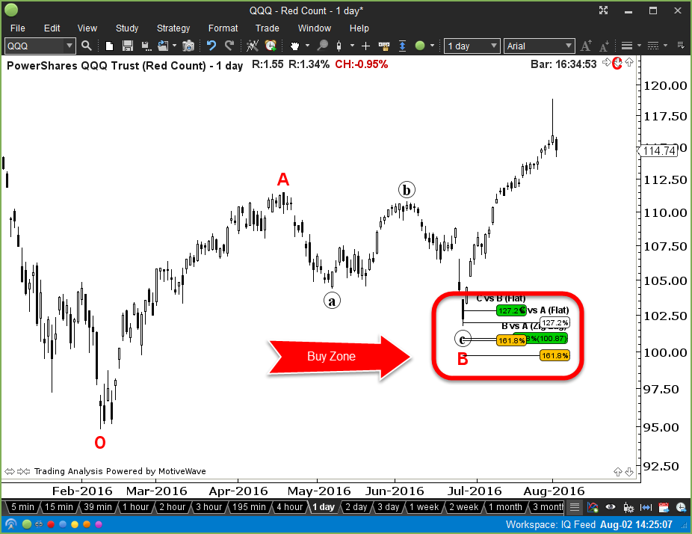

Slide 5
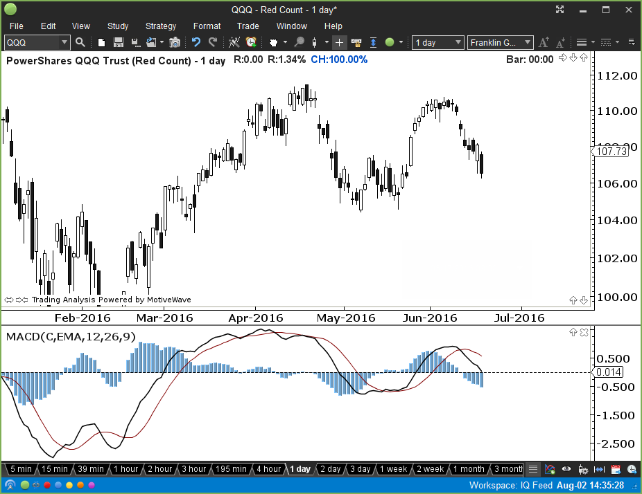
Still don’t believe you can’t trade without indicators? Let’s take a look!

Slide 6
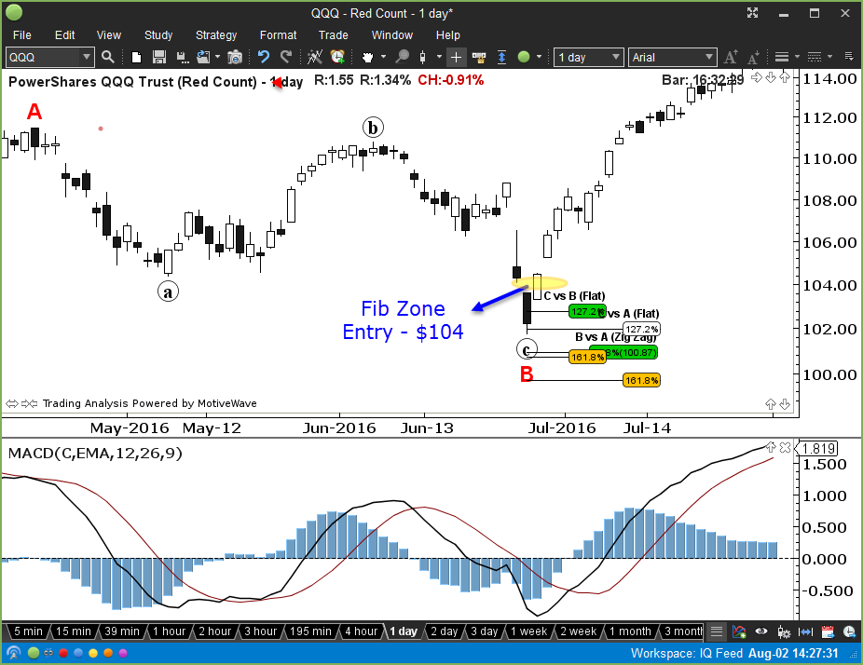

Slide 7
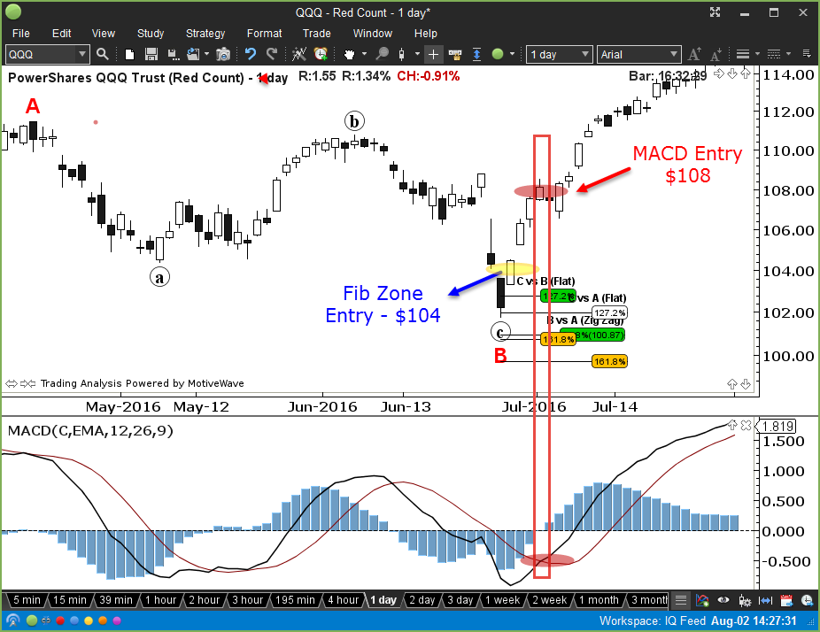

Slide 8
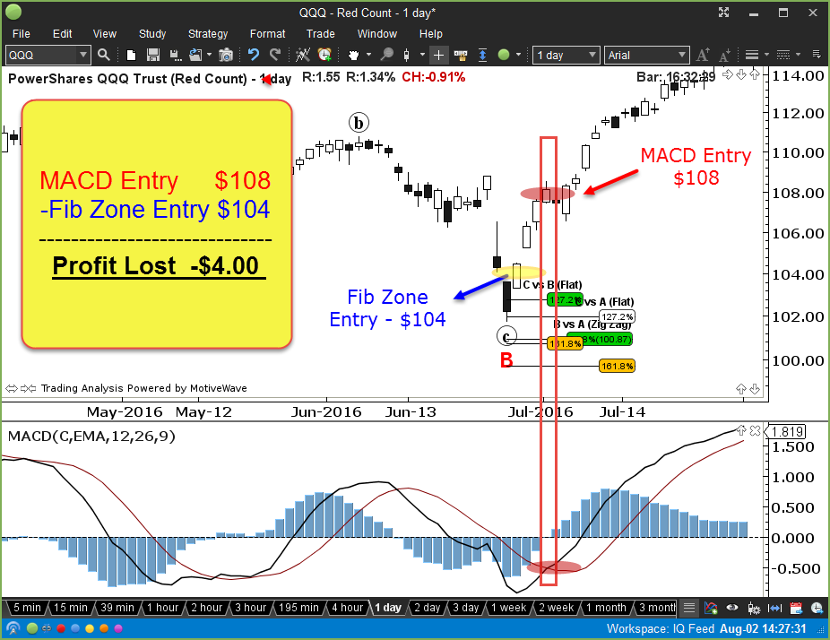

Slide 9
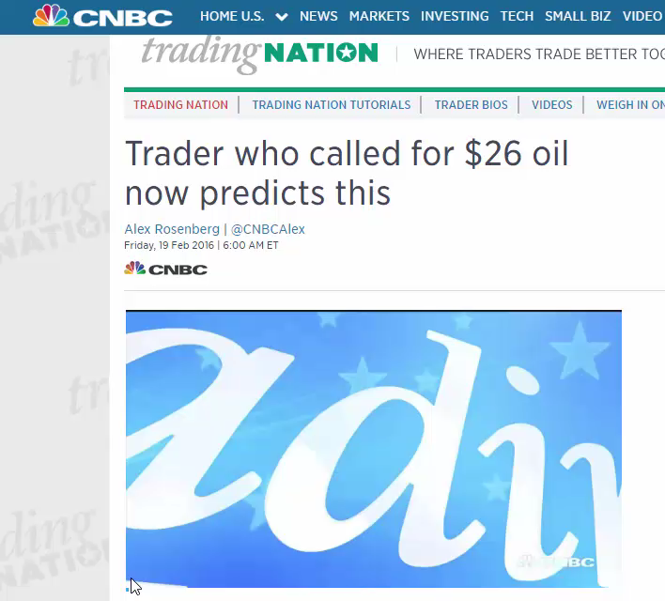

Slide 10
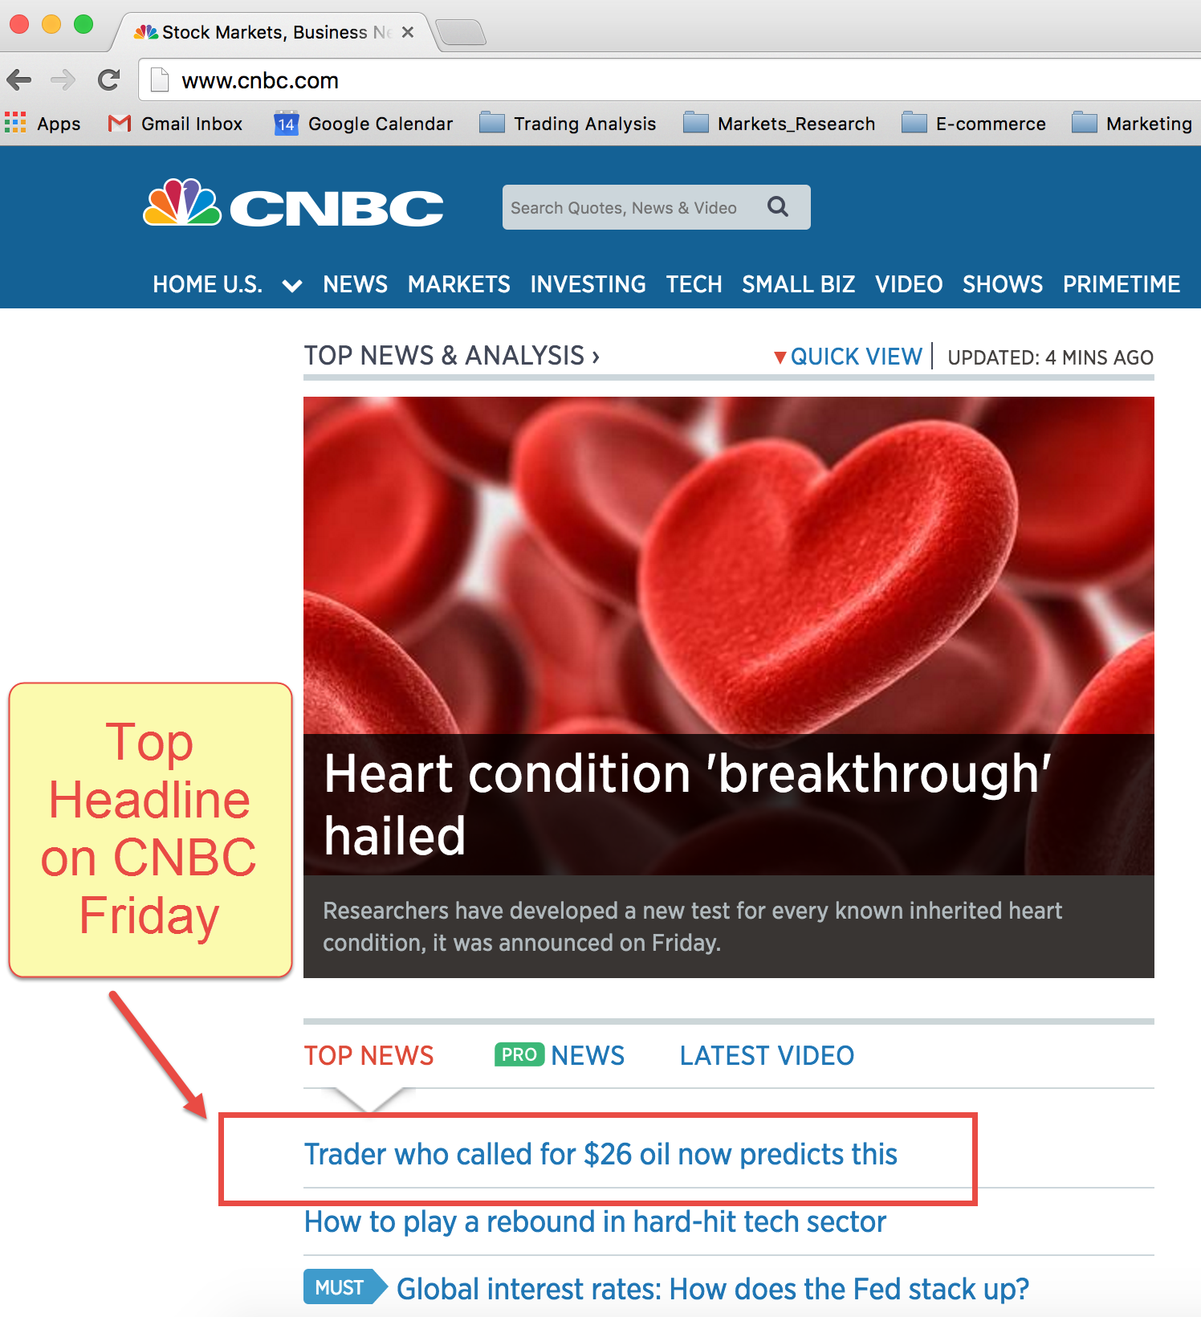
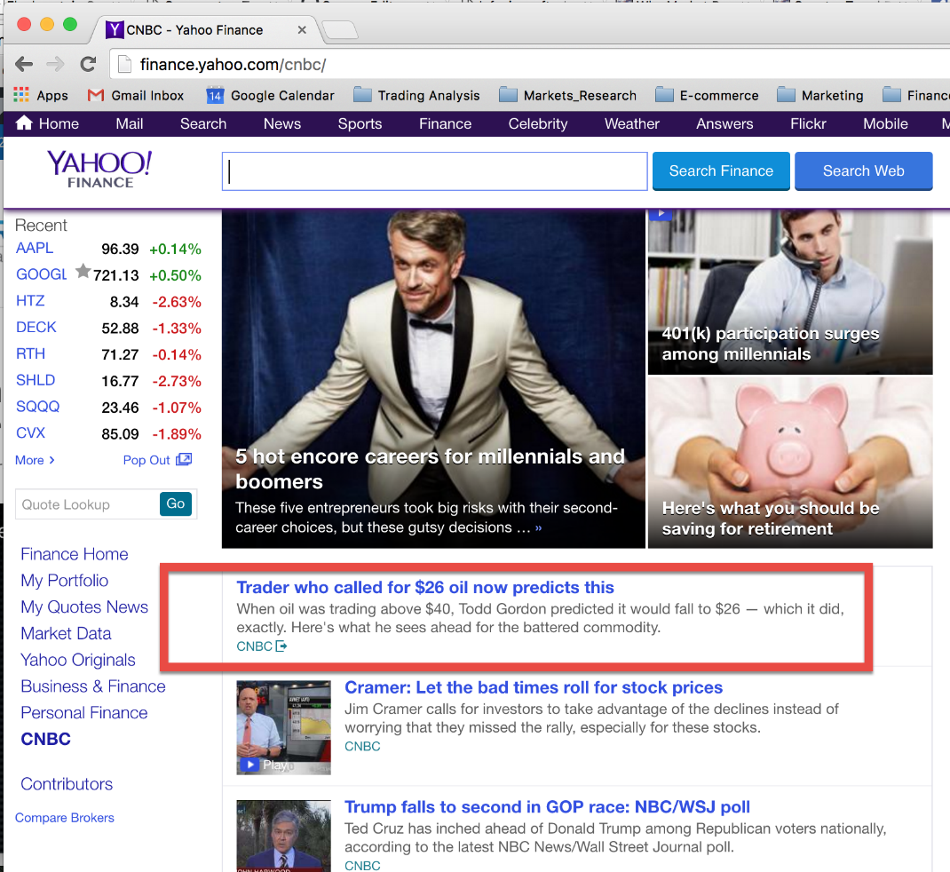
CNBC Crude Oil Low Called –Friday’s Top Story

Slide 11
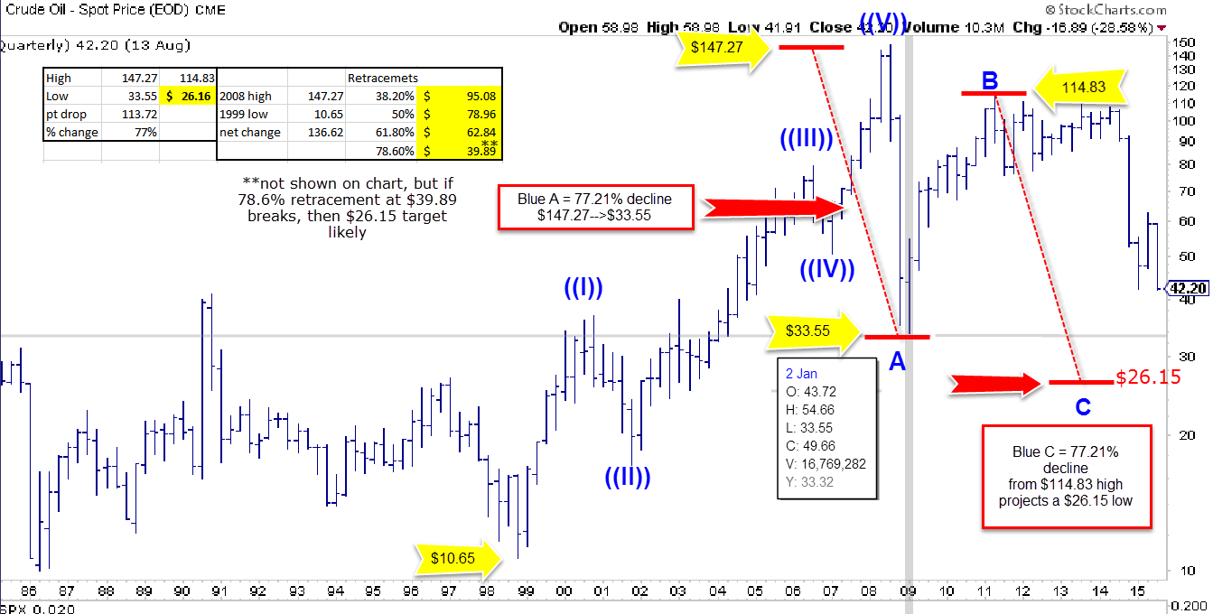

Slide 12
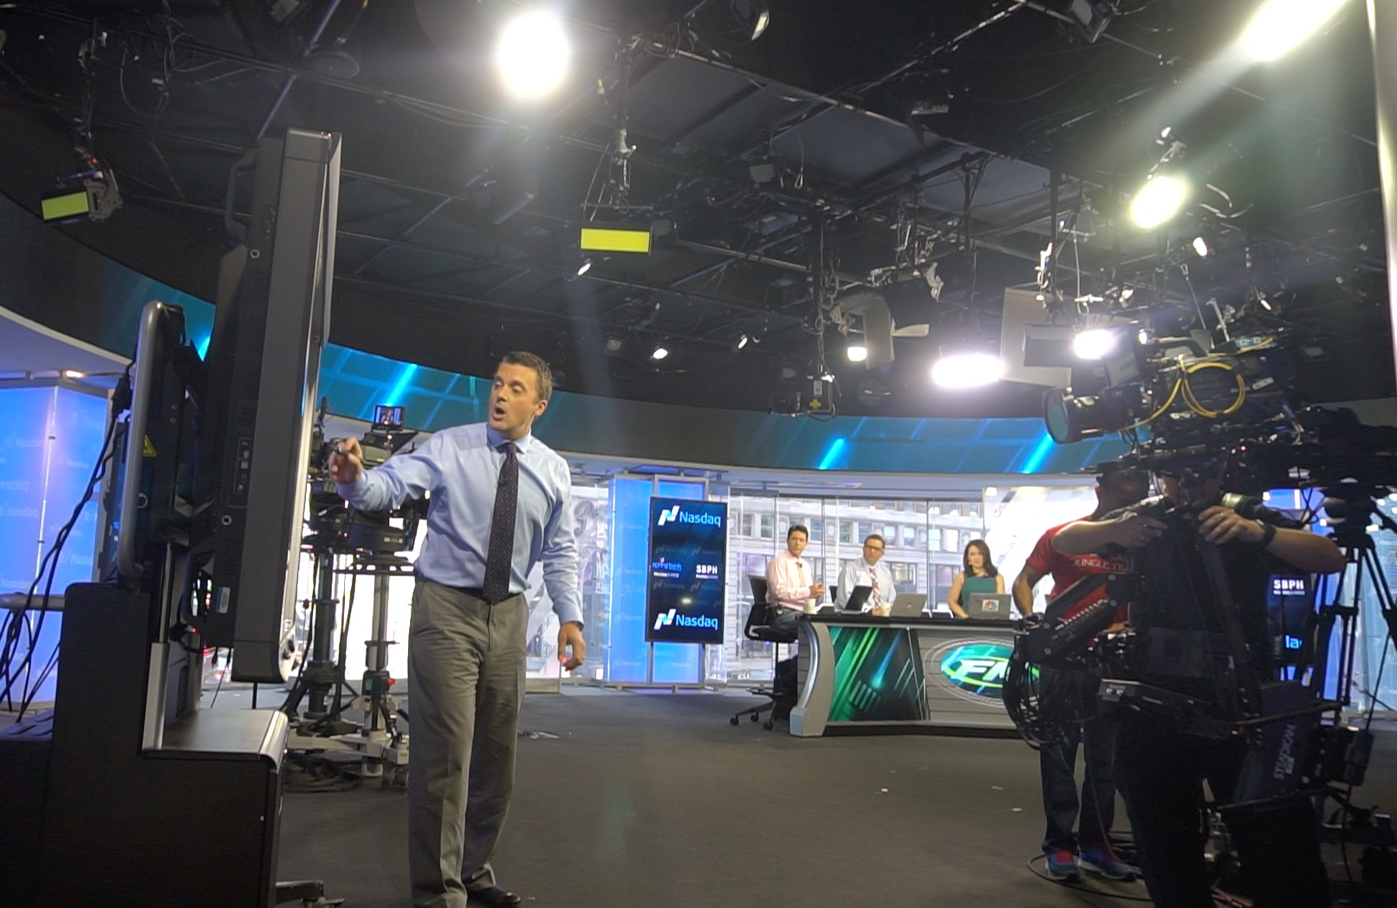

Slide 13

Anticipation Equals Performance
“Remember this: Anticipation is the ultimate power. Losers react; leaders anticipate.”
- Tony Robbins
Notes:
Anticipated Entries Equal Position of Strength
That’s why we use leading indicators – not lagging indicators.

Slide 14
Market Maker vs Market Taker
Do you react to the market or do you anticipate the market?
Few trading opportunities exist where you can simply “follow the herd”
Most trading opportunities require you to step outside of and AHEAD of the crowd.
Anticipating trades puts you in a position of strength…

Slide 15
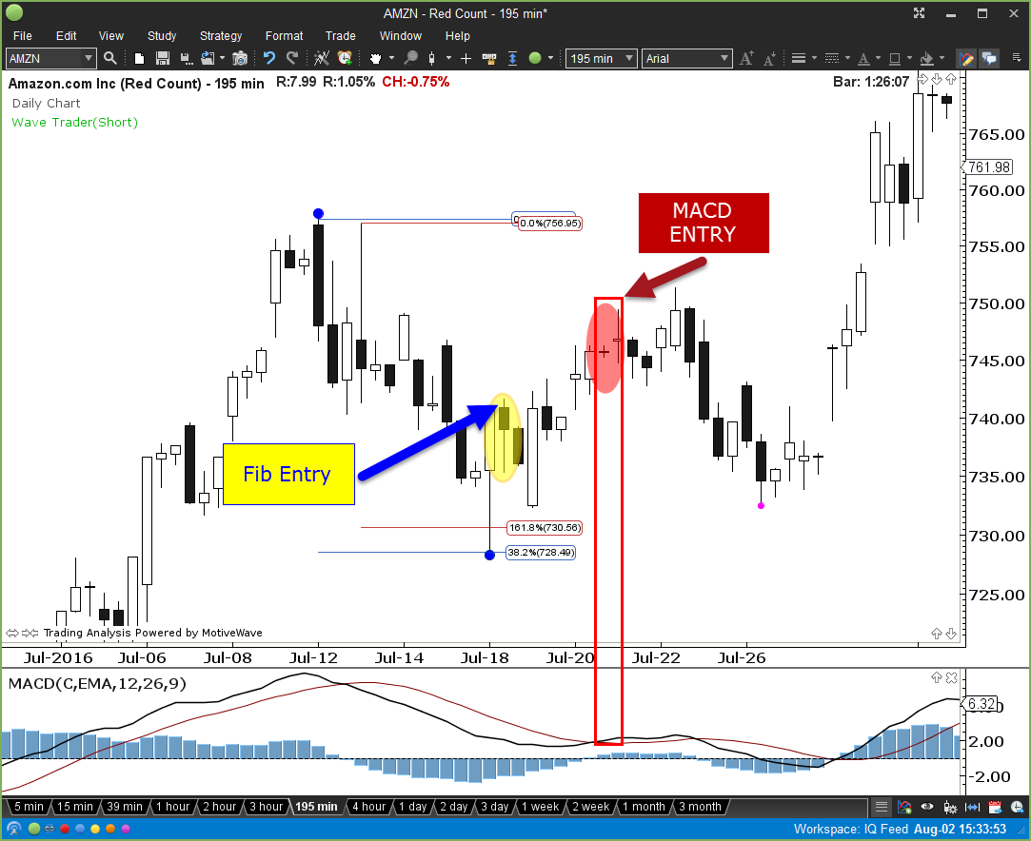
Trading From A Position Of Strength…

Slide 16


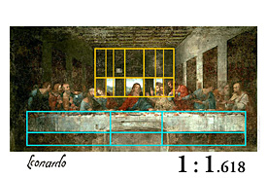

Slide 17
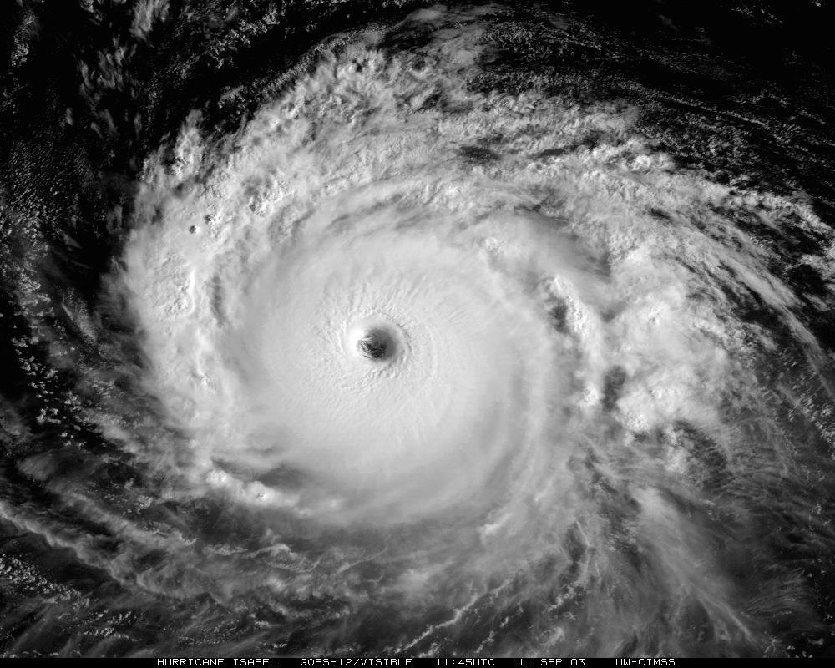
FIBONACCI
1.000
0.618
Notes:
Overlay a nautilus shell on top

Slide 18

FIBONACCI
0.382
0.618

Slide 19
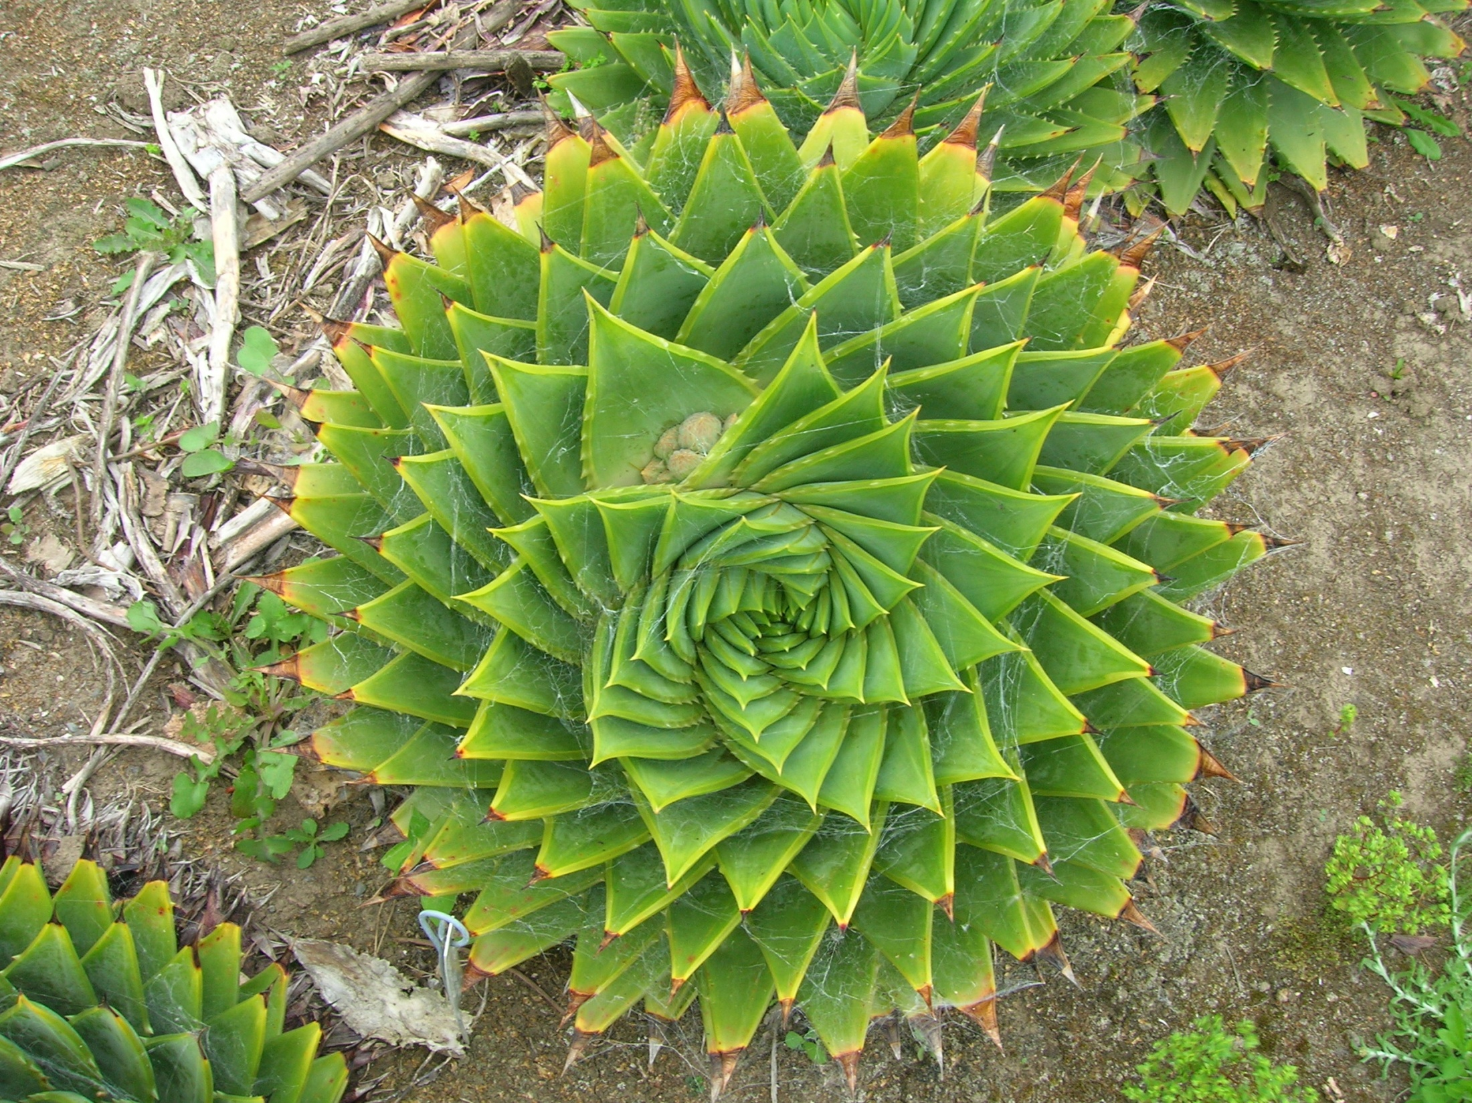

Slide 20

Fibonacci
0.382
0.618

Slide 21
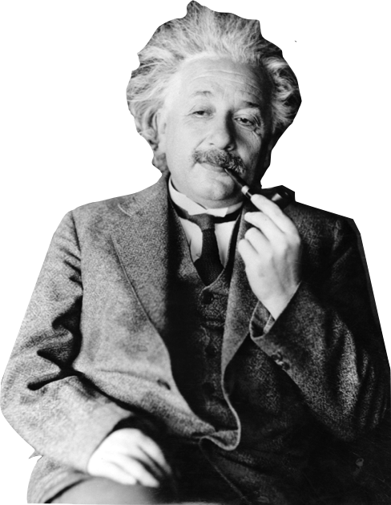
The Golden Ratio or Divine Proportion
Ancient civilizations identified this repeating ratio on a such a frequent and grand scale everywhere in the natural world, they thought it to be an ordained ratio from the gods, hence the name divine proportion
As it pertains to markets, Fibonacci is the “Da Vinci Code” . It helps to understand the seemingly erratic price patterns formed from the hopes, dreams, fears, and other emotions of the participating masses. It serves as our “secret decoder ring” to interpret the growth or decay of the masses’ interest in a particular security.
It helps to quantify the swings from mass euphoria to pessimism of a particular security, which then creates our opportunities.
“God does not play dice with the universe.”

Slide 22
Fibonacci #’s & Ratios
The Fib sequence each # is the sum of the two #’s preceding it, starting with 0 and 1.
- 0, 1, 1, 2, 3, 5, 8, 13, 21, 34, 55, 89, 144, 233, 377, etc.

Slide 23
Fibonacci #’s & Ratios
The Fibonacci Sequence
0, 1, 1, 2, 3, 5, 8, 13, 21, 34, 55, 89, 144, 233, 377, 610, 987, etc
Fib retracement ratios are the ratio of any # to it’s next higher #.
Example : 0/1 = 0 (Starting Point)
Example : 1/1 = 1 (Ending Point)
Example : 1/2 = 0.50 (Major retracement level)

Slide 24
Fibonacci #’s & Ratios
The Fibonacci Sequence
0, 1, 1, 2, 3, 5, 8, 13, 21, 34, 55, 89, 144, 233, 377, 610, 987, etc
Fib retracement ratios are the ratio of any # to it’s next higher #.
Once we cross the fourth set of fib #’s the ratios start to narrow down to the inverse of the Golden Ratio – 0.618
Example : 2/3 = .6666 3/5 = .6000
5/8 = .6250
8/13 = .6153
13/21 = .6190 21/34 = .6176
34/55 = .6181
55/89 = .6179
89/144 = .6180 144/233 = .6180
233/377 = .6180
377/610 = .6180

Slide 25
Fibonacci #’s & Ratios
The Fibonacci Sequence
0, 1, 1, 2, 3, 5, 8, 13, 21, 34, 55, 89, 144, 233, 377, 610, 987, etc.
Derive Fib Extension levels by taking the ratio of any # to its next lower #. The sequence narrows down to the Golden Ratio – 1.618
Example : 1/0 = 0 1/1 = 1
2/1 = 2.000
3/2 = 1.500
5/3 = 1.666
8/5 = 1.600
13/8 = 1.625
21/13 = 1.615
34/21 = 1.619
55/34 = 1.617
89/55 = 1.618
144/89 = 1.618

Slide 26
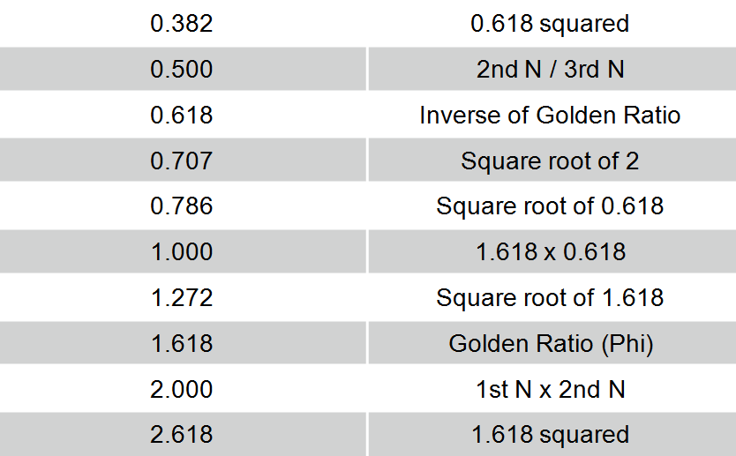
Fibonacci Ratios and Calculation

Slide 27

Fibonacci is so subjective!
The 3 main objections to Fib are….

Slide 28
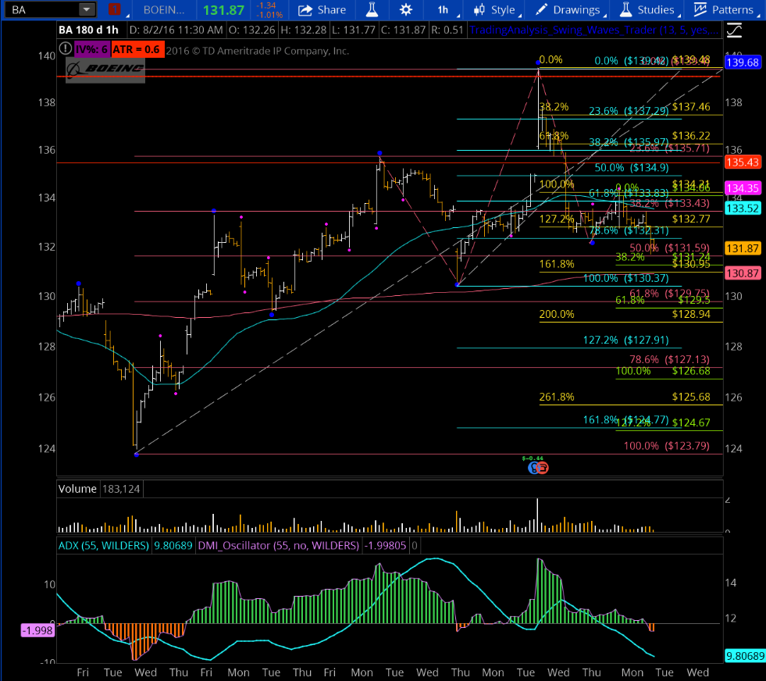
3 Main Objections To Fibonacci….
Where do I start and stop the Fib analysis?
2) Which one of these ratios will reverse the market trend?!
3) All the different tools are confusing!

Slide 29
Major and Minor Swing Waves
Minor swing wave – a brief reversal in the trend that IS NOT EXCEEDED in the 5 bars prior and the 5 bars following.
Major swing wave – a significant reversal in trend that is NOT EXCEEDED in the 13 bars prior and 13 bars following.
Notes:
- Get rid of the -

Slide 30
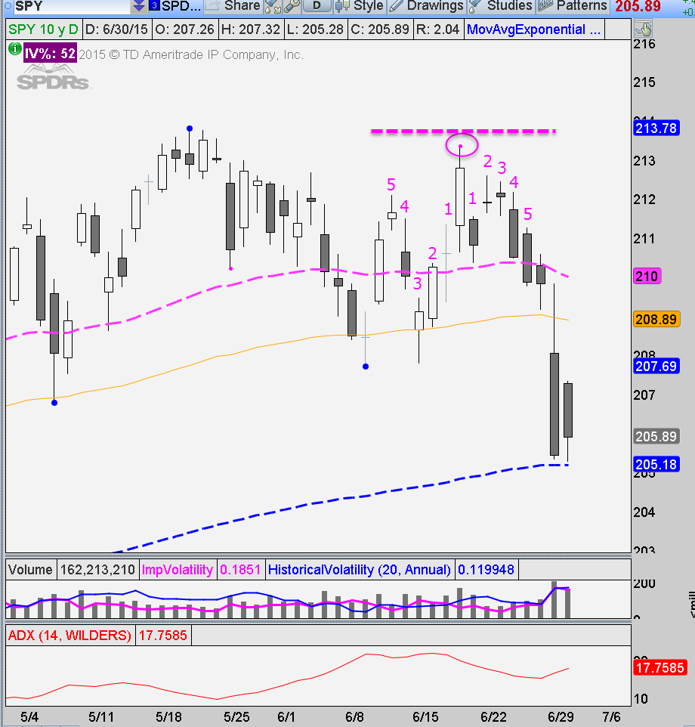
Minor Swing Wave
A brief reversal in the trend that IS NOT EXCEEDED in the 5 bars prior and the 5 bars following.
Minor Swing Wave High

Slide 31
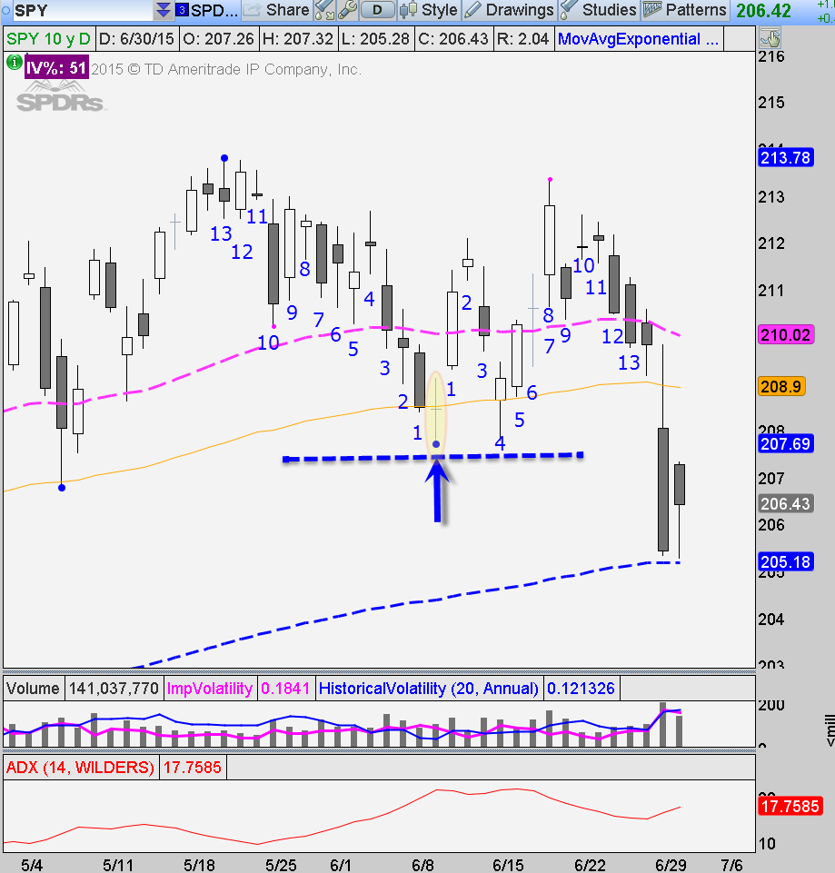
Major Swing Wave
A significant reversal in trend that is NOT EXCEEDED in the 13 bars prior and 13 bars following.
Major Swing Wave High
Major Swing Wave Low

Slide 32

Walk Before You Can Run
Let’s learn to identify trends and corrections before we jump into Fib Trading…

Slide 33
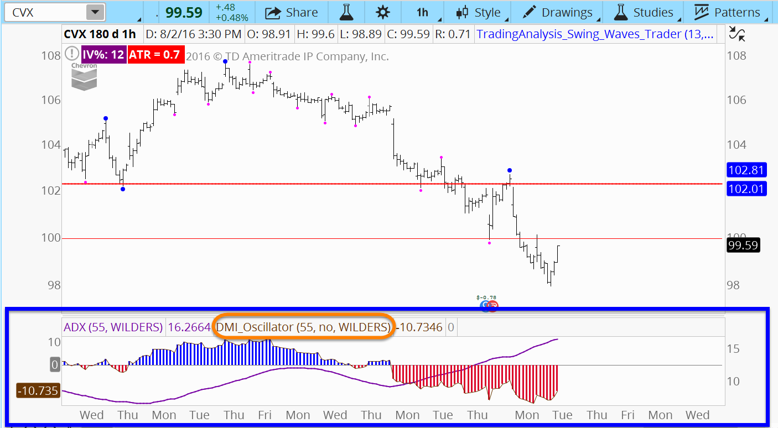
Identify The Predominant Trend
55 period DMI oscillator is the trend determinant
If oscillator is red 🡪 downtrend

Slide 34
Identify The Predominant Trend
55 Period DMI Oscillator gives you the trend of the market
ADX (purple line) gives you the strength of that trend. It does not give you direction of the trend
The higher the purple indicator, the stronger the trend

Slide 35
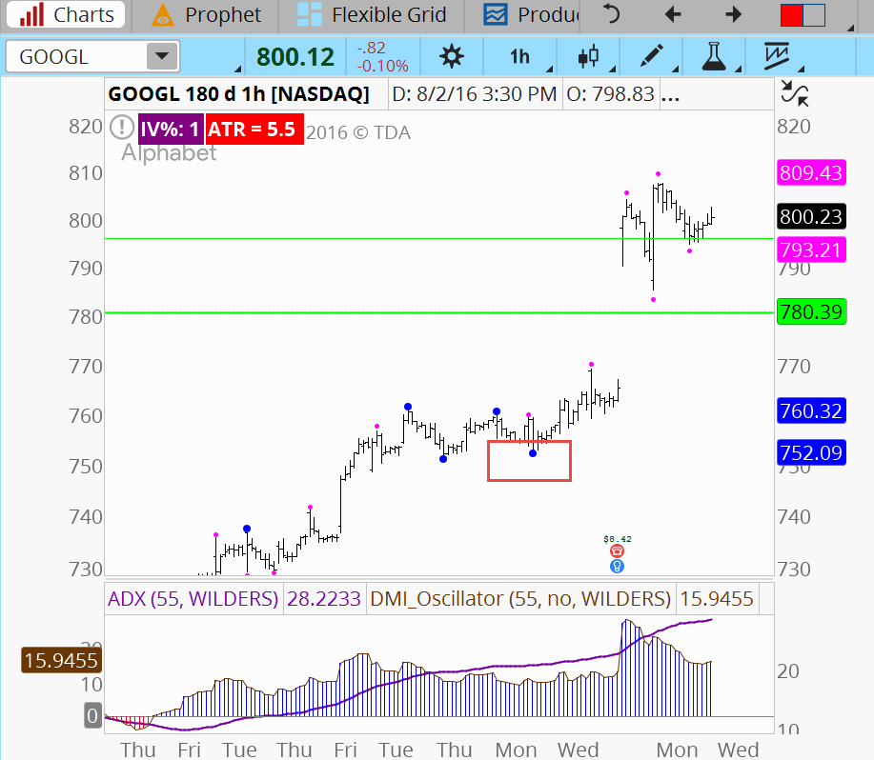
Isolate the Trend Waves
If the DMI Oscillator is positive, find the most recent major swing wave low (blue dot low)

Slide 36
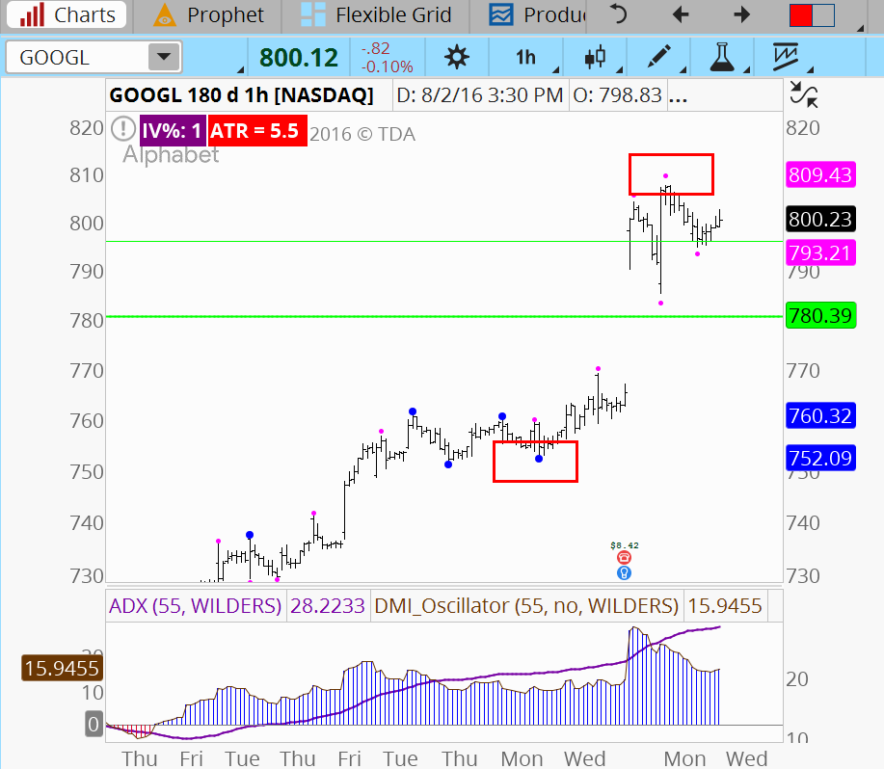
Isolate the Trend Waves
If the DMI Oscillator is positive, find the most recent major swing wave low (blue dot low)
Find the highest price of the trend

Slide 37
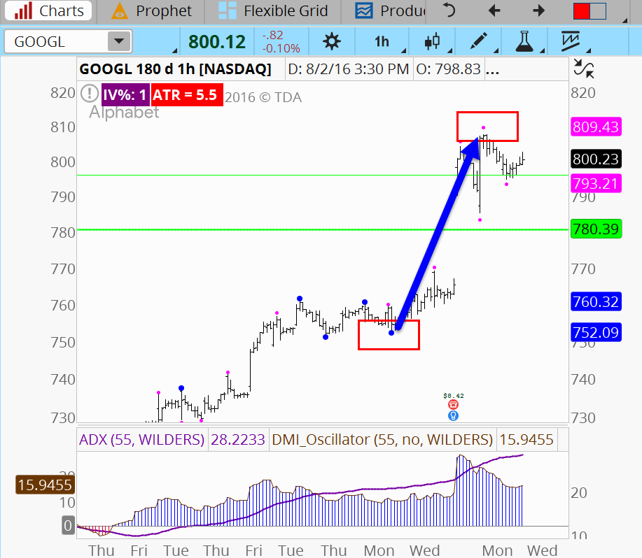
Isolate the Trend Waves
If the DMI Oscillator is positive, find the most recent major swing wave low (blue dot low)
Find the highest price of the trend
This is the most recent trend wave that you will use for a Fib calculation later on…

Slide 38
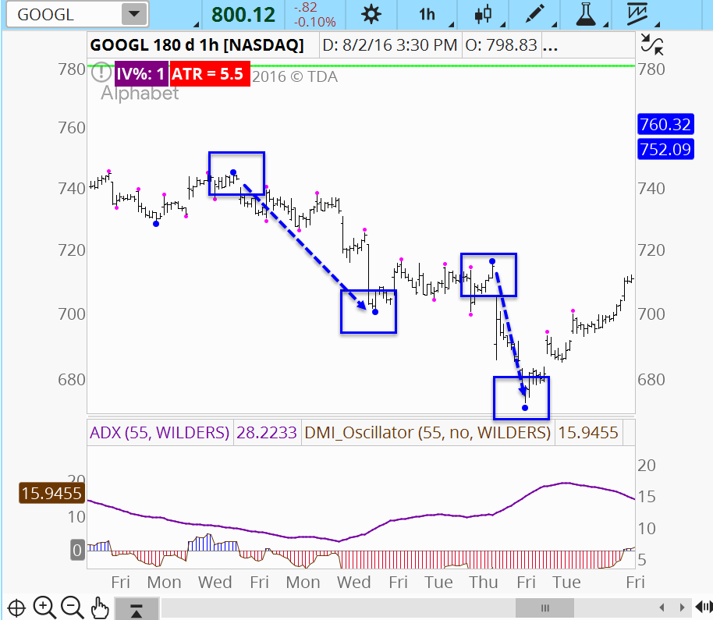
Isolate the Trend Waves
Looking to past price action, any blue dot to blue dot swing in the direction of the oscillator is a trend swing.
You will use these prior trend swings for Fib calculations later on

Slide 39
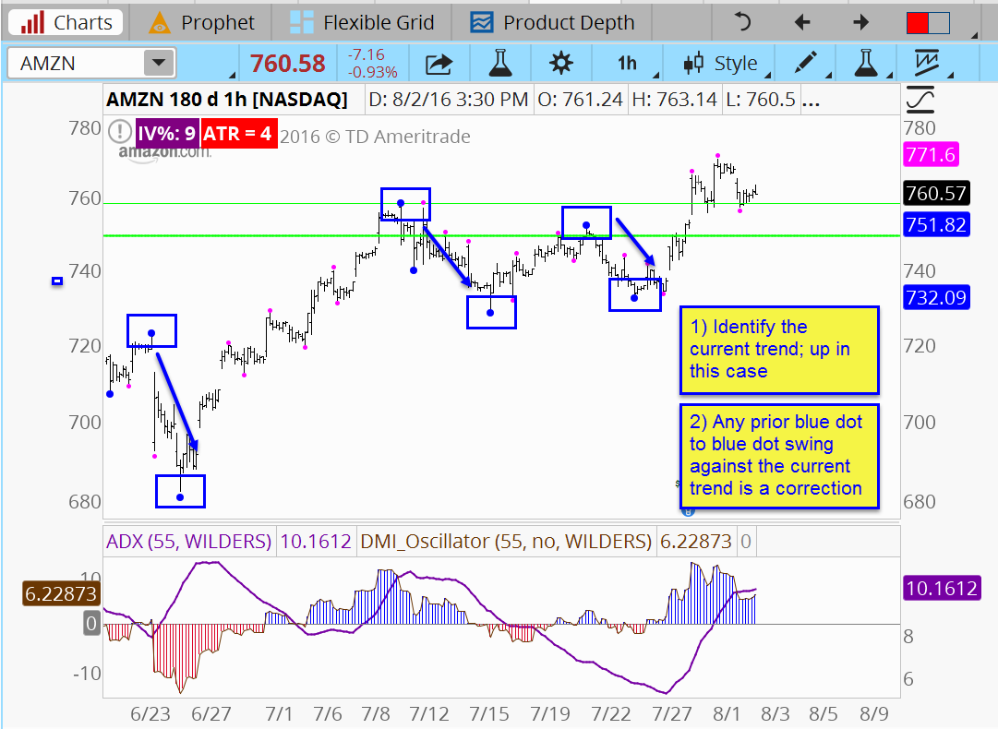
Isolate The Corrective Waves
Identify the current trend, up in this case
Any previous blue dot to blue dot swing against the current trend is a corrective wave
You will use these corrective waves for Fib calculations later on

Slide 40
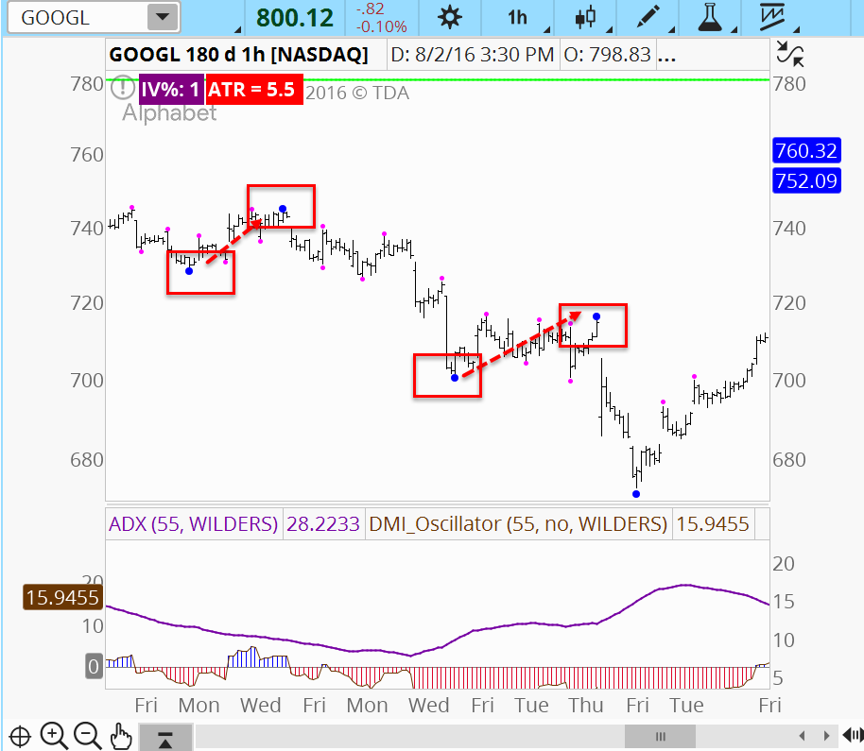
Isolate The Corrective Waves
Any blue dot to blue dot swing against the predominant trend is a corrective wave
Purple dot swings against the predominant trend are also corrections, though less significant.

Slide 41
Fibonacci Tool #1
Retracements

Slide 42
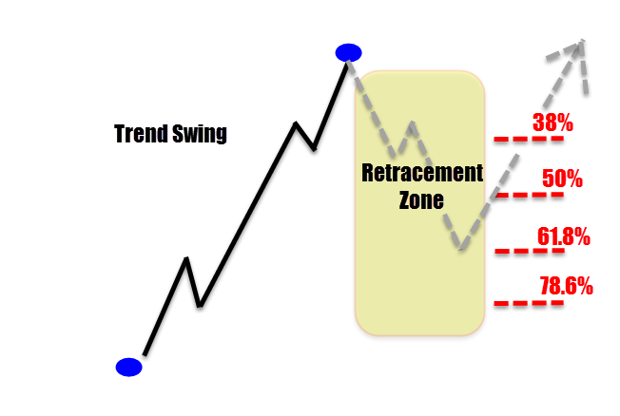
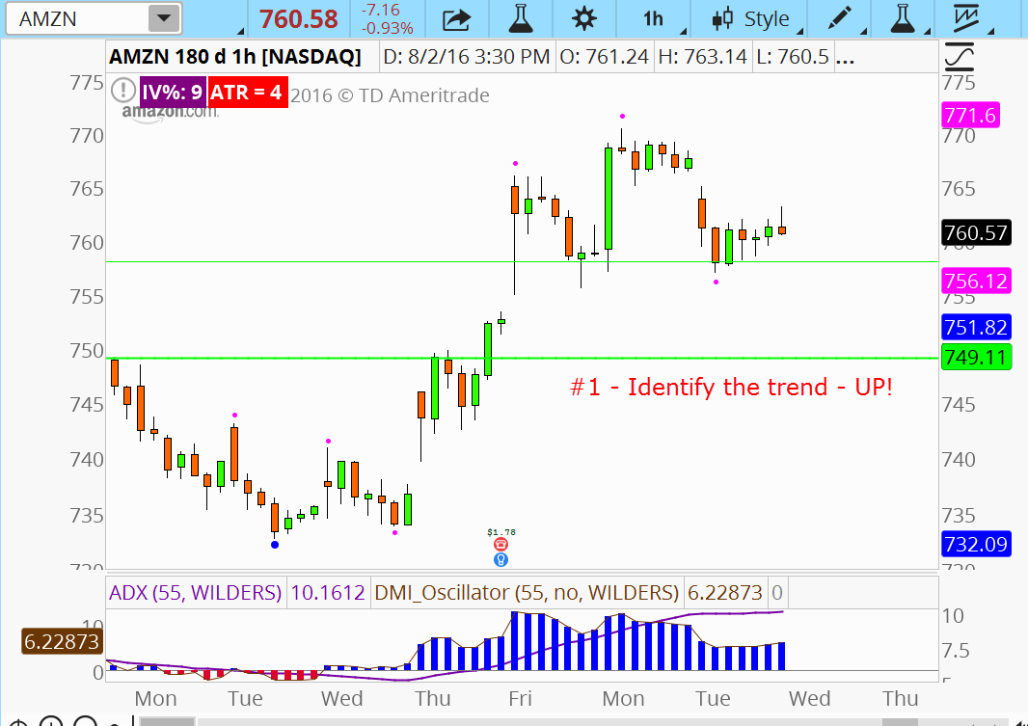
Retracements
Fib retracements study the on-going trend wave and provide an area that a future corrective wave could occupy.
Calculation
  Uptrend - Find a blue dot low, project to highest price following the blue dot low
  Downtrend – Find a blue dot high, project to lowest price following the blue dot low
Primary retracements
  23.6% (minor level)
  38%
  50%
  61.8%
  70.7% (minor level)
  78.6%

Slide 43
Applying Fib To Trend Waves

Slide 44
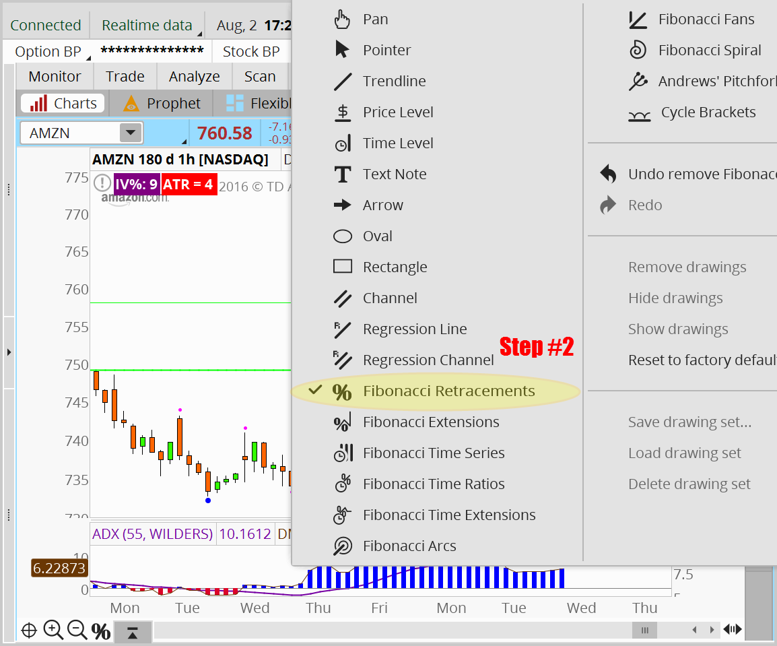
Applying Fib To Trend Waves

Slide 45
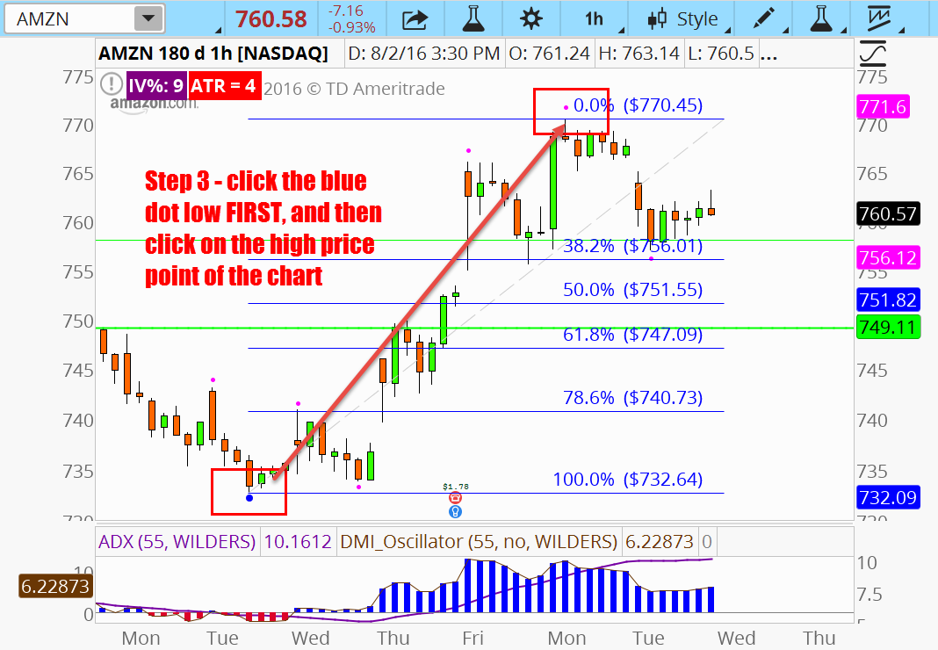
Applying Fib To Trend Waves

Slide 46

Fibonacci Retracements
Retracements ratio’s are
used to analyze
corrective Waves
38.2%
…. by measuring
previous trend waves
61.8%
100%
100%

Slide 47
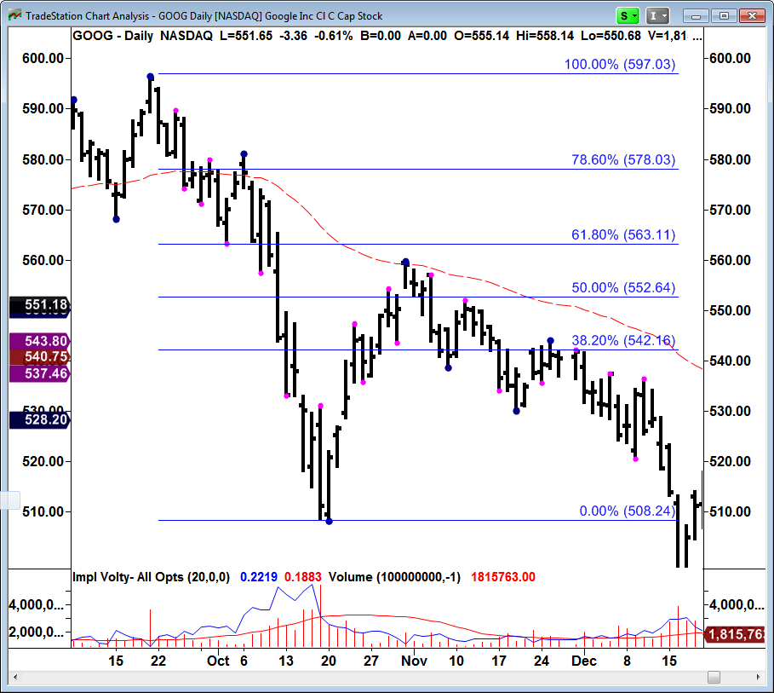
Retracements
Important Tip
For shorts, click swing wave high first, then swing wave low

Slide 48
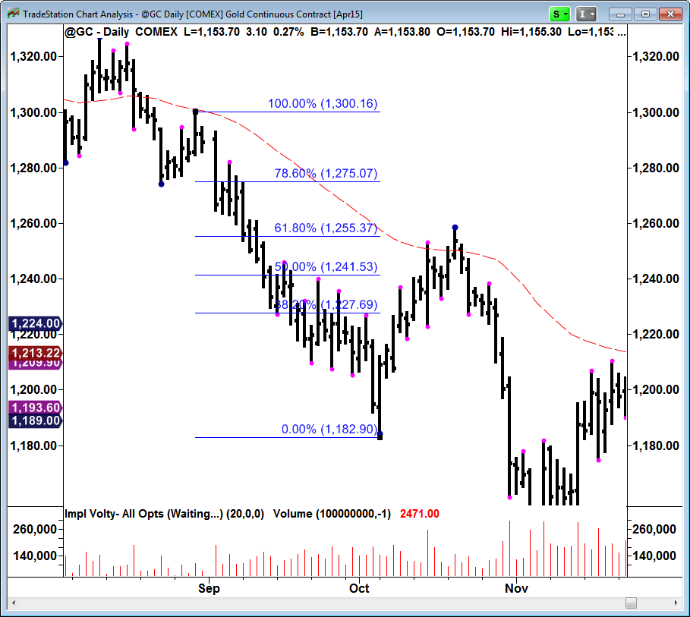
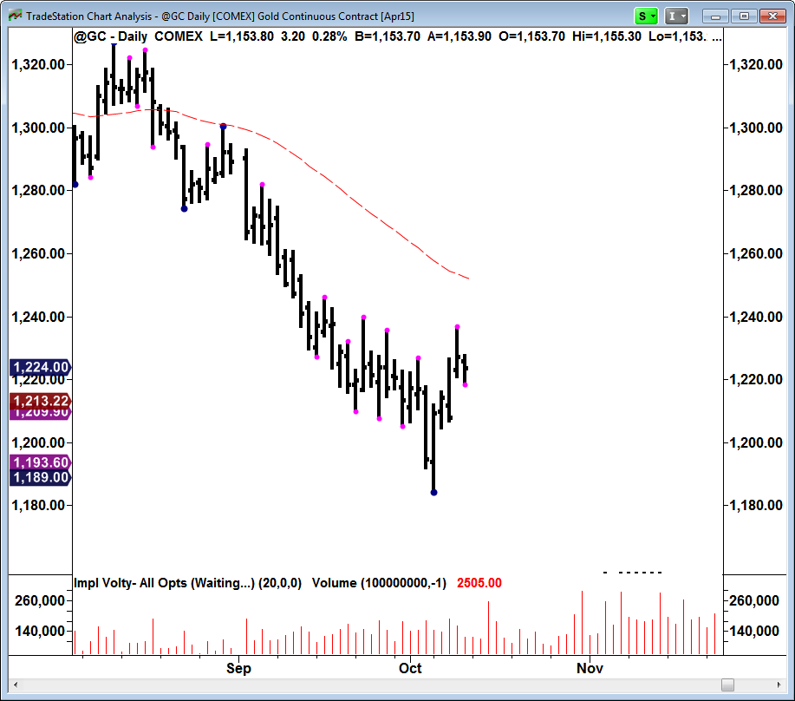
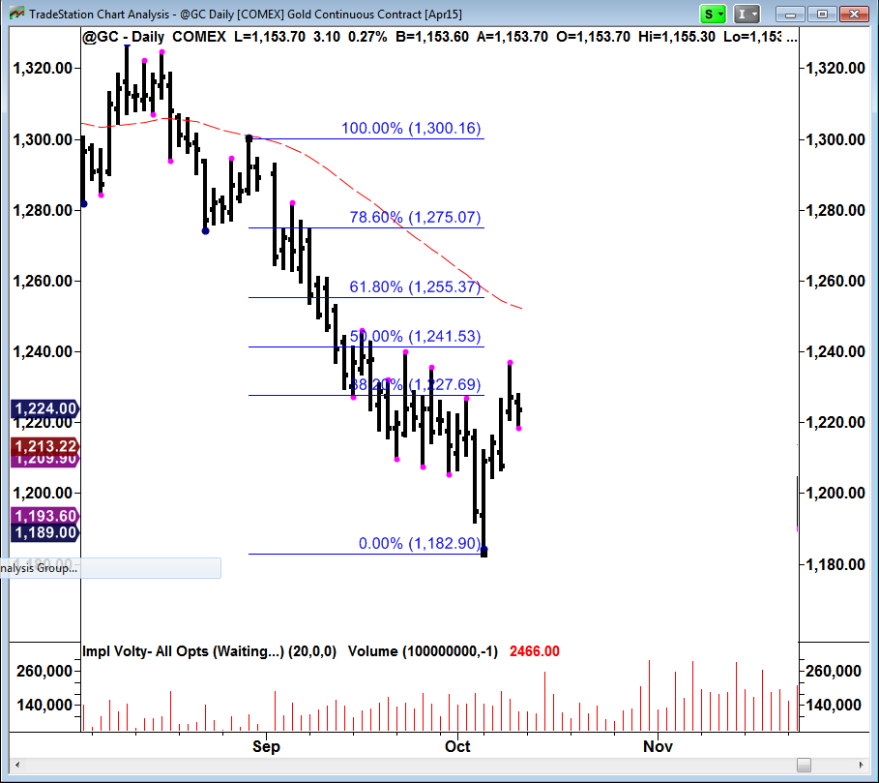
Retracements

Slide 49
Fibonacci #’s & Ratios
2.00
External Retracements
Projections
-For exits on trend trades
-For entries on counter trend trades
1.618
0.00
0.382
Retracements
-For entries
0.50
0.618
100.0

Slide 50
Fibonacci Tool #2
Extensions

Slide 51
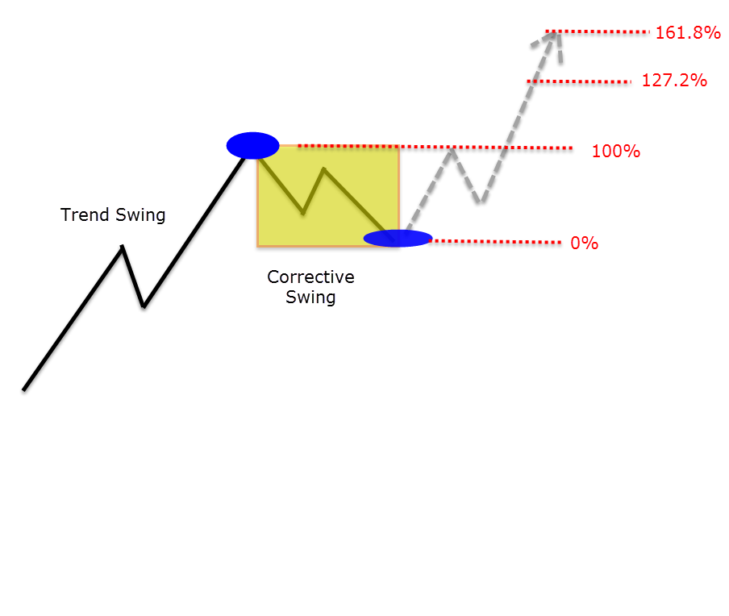
Fib Extensions
Fib extensions study an on-going corrective wave and provide targets for on-going trend wave
Calculation
  Uptrend - Find a blue dot high to the next swing low. Using retracement tool click swing high first, then swing low to calculate upside extension targets
  Downtrend – - Find a blue dot low to the next swing high. Using retracement tool click swing low first, then swing high to calculate downside extension targets
Extensions
  127.2%
  161.8%
  200%
  261.8%
  423.6

Slide 52
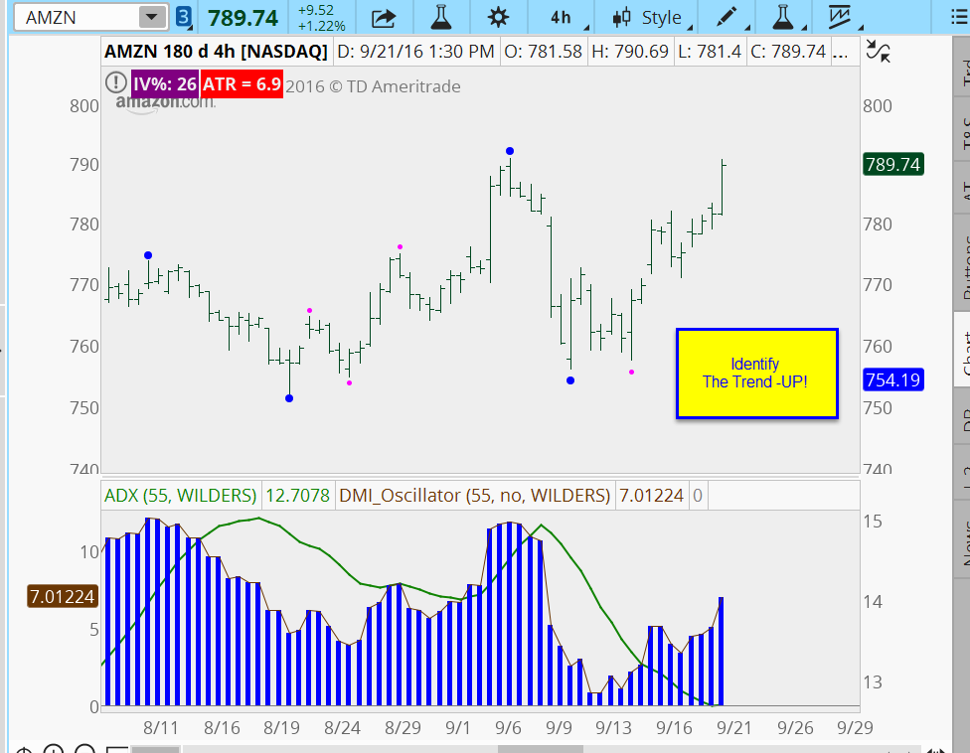
Applying Fib To Corrective Waves - Extensions

Slide 53
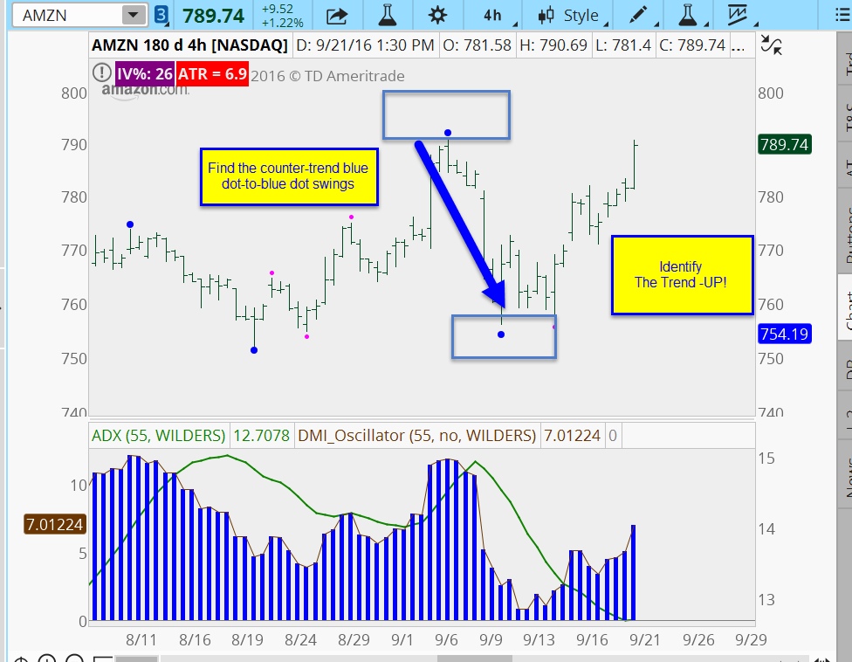
Applying Fib To Corrective Waves - Extensions

Slide 54
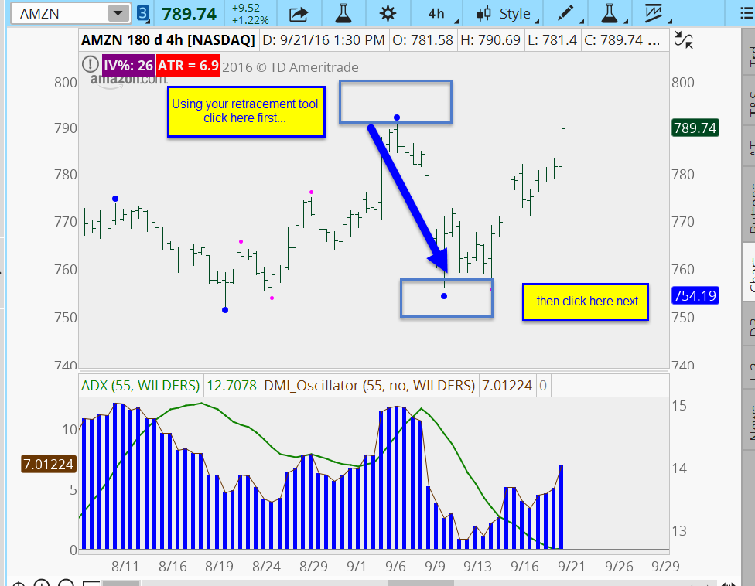
Applying Fib To Corrective Waves - Extensions

Slide 55
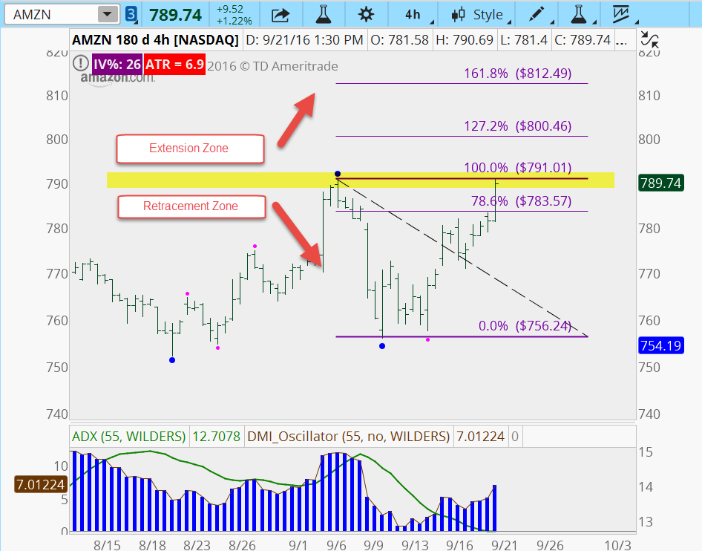
Applying Fib To Corrective Waves - Extensions

Slide 56
Fibonacci Tool #3
Projections

Slide 57
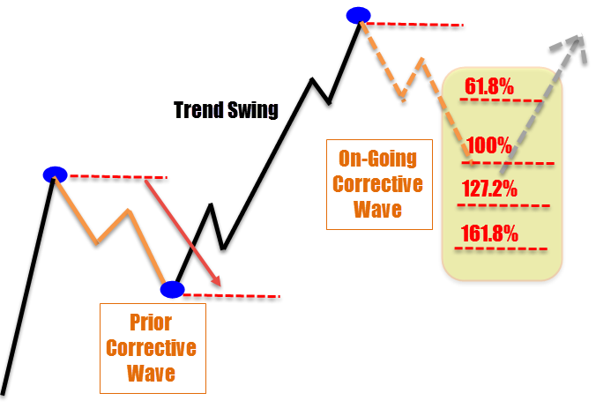
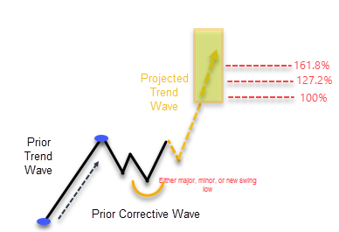
Fib Projections
Fib projection study a prior corrective wave and project the zone that a future corrective wave could occupy.
Calculations for corrections
  Uptrend (opposite for downtrends)
    Find a blue dot high to the next swing low.
    Using projection tool click swing high first, swing low next,
    Click a 3rd time from the current swing wave high.
Calculations for trends
  Uptrend (opposite for downtrends)
    Find a blue dot low to a blue dot high.
    Using projection tool click the blue dot low first, then click the blue dot high next.
    Click a 3rd time from the beginning of the on-going trend to project upside targets
Primary projections
  38%
  61.8%
  100%
  127.2%
  161.8%
  200%
  261.8%

Slide 58
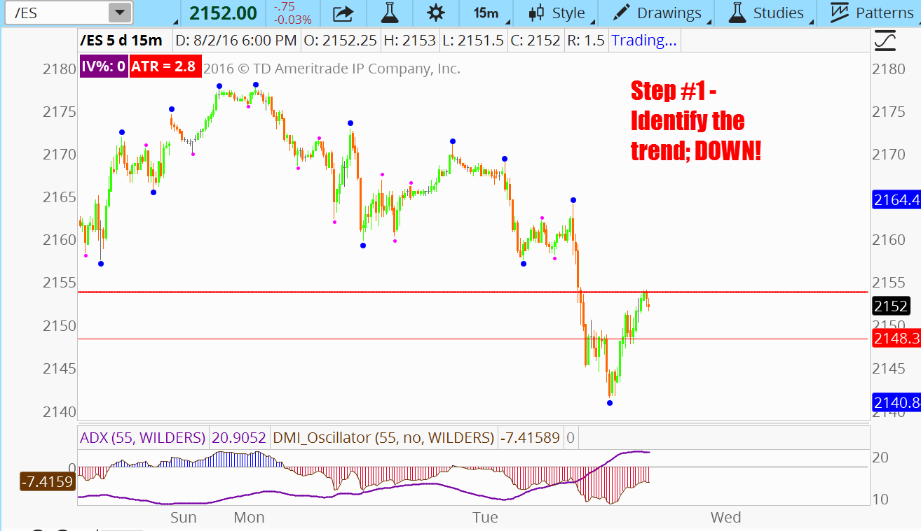
Fib Step #5 – Applying Fib To Corrective Waves

Slide 59
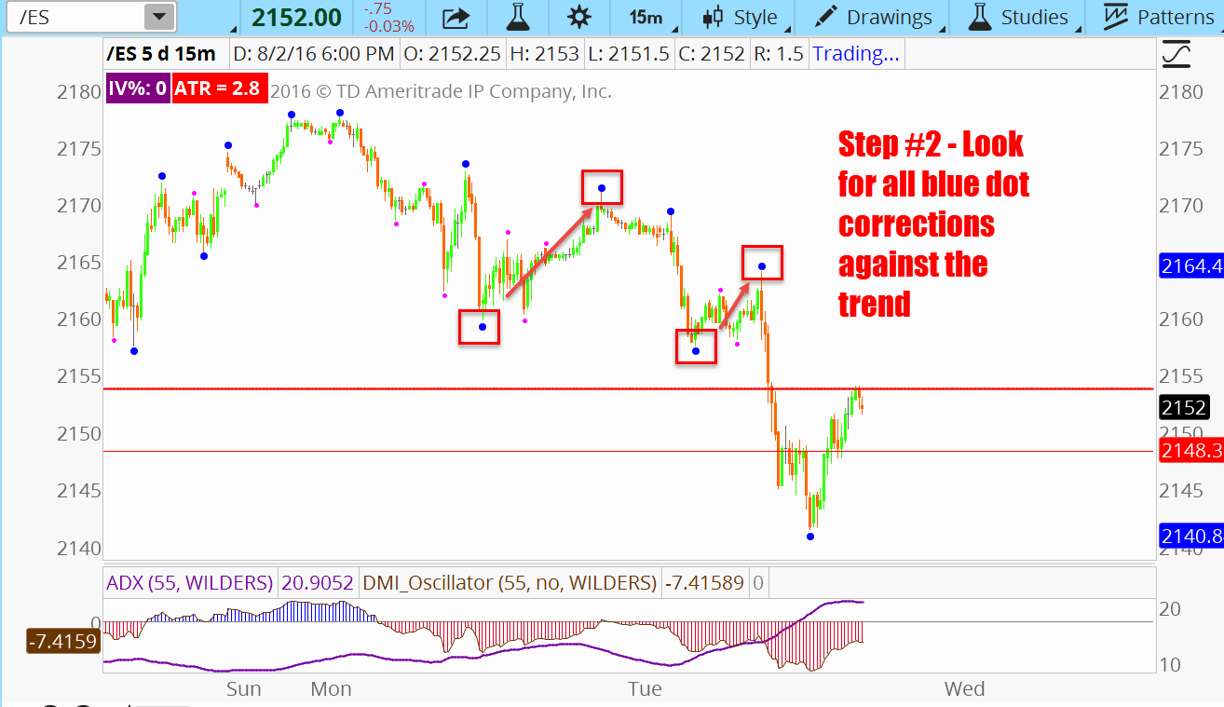
Fib Step #5 – Applying Fib To Corrective Waves

Slide 60
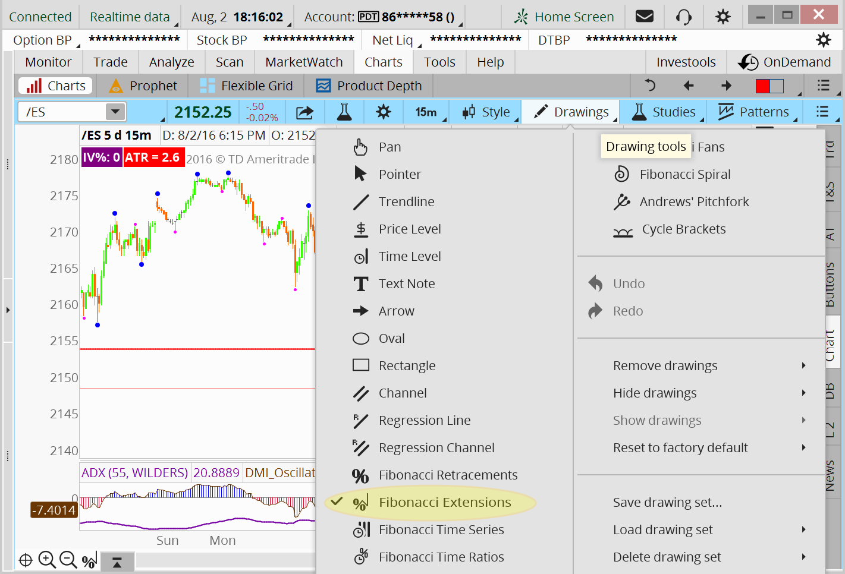
Fib Step #5 – Applying Fib To Corrective Waves

Slide 61
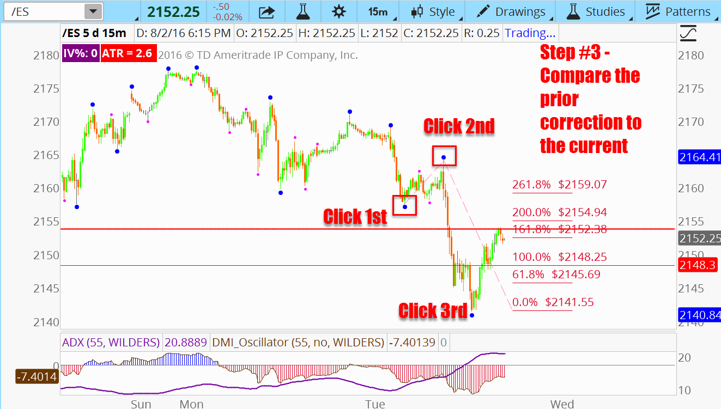
Fib Step #5– Applying Fib To Corrective Waves

Slide 62
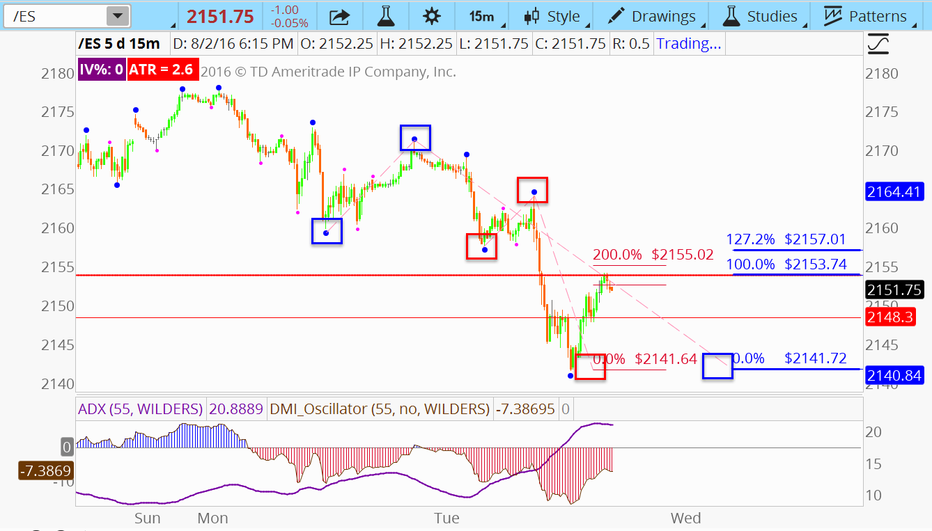
Fib Step #5 – Applying Fib To Corrective Waves

Slide 63
Stacking the Zone – FRZ’s, FSZ’s
A Fib zone is at least two Fib ratios in close proximity to each other
Combine any and all Fib tools: retracements, extensions & projections, symmetry to calculate a Fib Zone
F.S.Z = Fib Support Zone – a cluster or coincidence of at least 2 Fib levels that will offer support in a falling market
F.R.Z = Fib Resistance Zone – a cluster or coincidence of at least 2 Fib levels that will offer resistance in a rising market

Slide 64
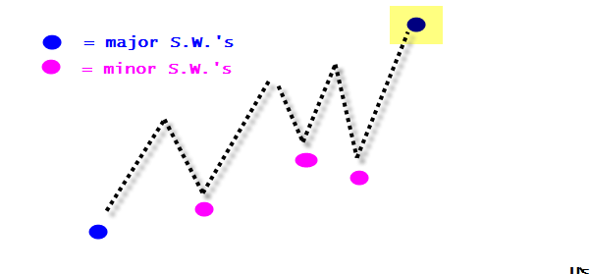
Forming Retracement Zones
We are going the “stack the zone” with multiple retracement levels to fortify the support level for longs / resistance level for shorts. Trading Fib support / resistance made up of 1 level is actually a low probability event. We are going to stack the zone!
    For LONGS -
      Major swing wave high - Find the major swing wave high and use that as your “mast”

Slide 65
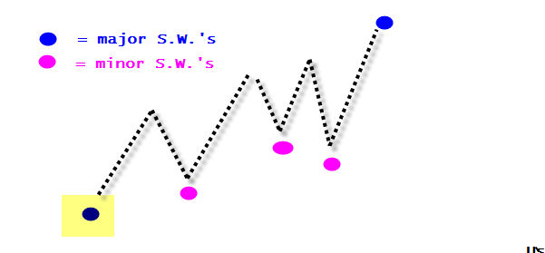
Forming Retracement Zones
We are going the “stack the zone” with multiple retracement levels to fortify the support level for longs / resistance level for shorts. Trading Fib support / resistance made up of 1 level is actually a low probability event. We are going to stack the zone!
    For LONGS -
      Major swing wave high - Find the major swing wave high and use that as your “mast”
      Major swing wave low – Find the most recent major swing wave low and use that as your “anchor”.

Slide 66

Forming Retracement Zones
We are going the “stack the zone” with multiple retracement levels to fortify the support level for longs / resistance level for shorts. Trading Fib support / resistance made up of 1 level is actually a low probability event. We are going to stack the zone!
    For LONGS -
      Major swing wave high - Find the major swing wave high and use that as your “mast”
      Major swing wave low – Find the most recent major swing wave low and use that as your “anchor”.

Slide 67

Forming Retracement Zones
We are going the “stack the zone” with multiple retracement levels to fortify the support level for longs / resistance level for shorts. Trading Fib support / resistance made up of 1 level is actually a low probability event. We are going to stack the zone!
    For LONGS -
      Major swing wave high - Find the major swing wave high and use that as your “mast”
      Major swing wave low – Find the most recent major swing wave low and use that as your “anchor”.
      Minor swing wave lows – If there are minor swing wave lows, use those to draw new Fibonacci retracement levels.

Slide 68

Forming Retracement Zones
We are going the “stack the zone” with multiple retracement levels to fortify the support level for longs / resistance level for shorts. Trading Fib support / resistance made up of 1 level is actually a low probability event. We are going to stack the zone!
    For LONGS -
      Major swing wave high - Find the major swing wave high and use that as your “mast”
      Major swing wave low – Find the most recent major swing wave low and use that as your “anchor”.
      Minor swing wave lows – If there are minor swing wave lows, use those to draw new Fibonacci retracement levels.
        **Rule, if there are 2 in a close vicinity to each other use the lowest swing and the furthest to the right . You can use earlier swing lows, but only if they are lower then the current. This is the start of a zone.

Slide 69

Retracement Zones - Google

Slide 70

Retracement Zones - Google

Slide 71

Retracement Zones - Google

Slide 72

Retracement Zones - Google

Slide 73

Retracement Zones – NFLX

Slide 74

Retracement Zones – NFLX

Slide 75


Slide 76

WTI Crude Oil Trade – Jan 30th

Slide 77



Slide 78


USO 30 Min

Slide 79
What if we are stopped out?
If you are stopped out on the first 3-wave swing entry, you can consider re-entering the position with a newly formed swing wave low (for longs) and a subsequent move above the high of that new swing wave low PROVIDED you are above the .786 retracement of the move from the major swing wave low.
Ideally price is above the .786 retracement of the major swing wave low to high, as well as a minor swing wave low to high.

Slide 80

What if we are stopped out?

Slide 81

What if we are stopped out?

Slide 82

What if we are stopped out?

Slide 83

What if we are stopped out?

Slide 84

What if we are stopped out?

Slide 85
External Retracements
127.2%
261%
Ext. Ret. ratio’s are
used to analyze trend
waves
…. by measuring
previous corrective
waves.

Slide 86
External Retracements
Key Ratios
  127.2 %
  161.8 %
  200.0 %
  261.8 %
  423.6%
    Helps determine the completion of a trend wave
    Serves as potential Exit levels for trades in the direction of the larger trend
    Serves as potential entry for contra-trend trades

Slide 87
External Retracements
2.00
1.618
Extensions for Exit
Identify a completed
correction & anticipate a
new trend wave
1.272
1.00
0.618
Measure corrective wave
to define extension levels
0.000
Watch for the end of
correction for entry

Slide 88

External Retracements
Quick Tip
You are going to use the retracement tool for this study. It’s simply a retracement that is more than 100%

Slide 89

External Retracements
Quick Tip
Below the 100% is retracement territory. Above 100% is extension territory

Slide 90

External Retracements

Slide 91

External Retracements

Slide 92

External Retracements

Slide 93


Creating a Zone With Extensions
Two or more corrections in the course of a trend can be used to project the end of a trend

Slide 94
Creating a Zone With Extensions
Two or more corrections in the course of a trend can be used to project the end of a trend

Slide 95

Crude Oil – Multiple Extensions

Slide 96

Crude Oil – Multiple Extensions

Slide 97

Crude Oil – Multiple Extensions

Slide 98


Slide 99
Fibonacci Projections
200%
Projections are
used to measure trend
waves
…. by measuring
previous trend &
corrective waves.

Slide 100
Fibonacci Projections
Key Ratios
  38.2 %
  61.8 %
  100.0 %
  127.2%
  161.8 %
  200.0 %
  261.8 %
  423.6%
    Helps determine the completion of a trend wave (W.1,3,5,A or C).
    Serves as potential Exit levels for trades in the direction of the larger trend, or entry levels against the trend.
    Serves as potential entry on counter-trend trades

Slide 101
Fibonacci projections
1.618
projections for Exit
Identify a completed
trend & Correction &
anticipate a new 5-wave
trend.
1.000
0.618
5
Click 2
3
B
Measure (click) the 3
end points of the trend
& Corrective Wave.
Click 3
0.000
1
4
A
C
Watch for the end of
the trend wave at
projections ratios for exit.
2
Click 1

Slide 102

Projections – Crude Oil

Slide 103

Projections – Crude Oil

Slide 104


Slide 105


Slide 106


Slide 107


Slide 108
Fibonacci Expansions
200%
161.8%
Expansions measure the
current trend wave…
100%
…. to project the
end of the on-going
trend wave.

Slide 109
Fibonacci Expansions
Key Ratios
  38.2 %
  61.8 %
  100.0 %
  127.2%
  161.8 %
  200.0 %
  261.8 %
  423.6%
    Helps determine the completion of a trend wave (W.1,3,5,A or C).
    Serves as potential Exit levels for trades in the direction of the larger trend, or entry levels against the trend.
    Serves as potential entry on counter-trend trades

Slide 110
Fibonacci projections
1.618
Identify a completed
trend and corrective wave
1.000
0.618
2. Anticipate a new
trend wave. Measure (click)
the 2 end points of the
trend wave, click a 3rd time
Click 2
Click 3
Watch for the end of
the trend wave at
projections ratios for exit.
Click 1

Slide 111

Symmetry
Symmetry is similar to projections in the waves under study are not adjacent, or connected, to each other. Projections are comparing alternate trend waves to each other. Symmetry is comparing non-adjacent corrective waves. Many times corrections in the course of a trend are similar in length.
And if true symmetry does not hold , 100%, swings can be related by the Fib ratios; 0.618, 1.0, 1.272, 1.618, 2.0, and 261.8

Slide 112

Freeport McMoran Weekly - $12.57

Slide 113

Exxon Mobil – 3 HR- $2.70

Slide 114

Goldman Sachs 3 HR - $10.34

Slide 115

Trading A Fib Zone
In the prior webinar we talked about top losses going immediately below the low of final swing wave low in a bearish A-B-C correction setting up a long trade.
In some cases being whipsawed out of trades prematurely is a quite common. Instead we can place stop losses just below the low of a Fib support zone in the case of longs, and just above the FRZ in the case of shorts.
How look for tightly clustered Fib levels and eliminate extraneous Fib levels to create zones.

Slide 116


Goldman Sachs FSZ Trade

Slide 117

Goldman Sachs FSZ Trade

Slide 118

Goldman Sachs FSZ Trade

Slide 119

Goldman Sachs FSZ Trade
Long

Slide 120

Goldman Sachs FSZ Trade
Long

Slide 121

Goldman Sachs FSZ Trade
Long

Slide 122

Apex Buy / Sell
“Apex Buy / Apex Sell”
  Longs
    The lowest-low compared to the 2 prior bars. Makes a new low but closes above the prior bar’s close and the current bar’s open.
  Shorts
    The highest-high compared to the 2 prior bars. Makes a new high but closes below the prior bar’s close and the current bar’s open.
  Stop loss – one tick beyond the reversal bar extreme.

Slide 123

Psycho Buy / Sell
“Psycho Buy, Psycho Sell”
  Longs
    Bar 1 – is the lowest-low compared to the 2 prior bars. Makes a new low with an open in the higher 1/3rd of the bar’s range and the low in the bottom 1/3 of the bar’s range.
    Bar 2 – the open is the bottom 1/3rd of the range, and close is in the top 1/3rd of the bars range.
    Stop loss 1 tick below the lower of the two bars

Slide 124

Explosion Buy / Sell
  Longs
    Current bar is the lowest-low of prior 10 bars
    Daily range must be largest range in prior 10 bars
    Close must be in the top 25% of Explosion bar
    Bar following Explosion buy, buy stop entry 1 tick above high of Explosion bar
    Stop loss – 1 tick below the low of the Explosion bar

Slide 125

Outside Bar Trend Reversal
  This is the only trigger that is not initiated at the close of the bar. This is in an intra-bar entry.
  Longs
    Is an outside bar and is the lowest-low compared to the 2 prior bars
    Entry – 1 tick above the high of the bar prior to the outside bar
    Stop loss – 1 tick below the low of that entry bar
    Exit on close of bar if current bar close is below current bar open and prior bar’s close.

Slide 126

Shy Guy Buy / Sell
  Longs
    Enter only direction of trend (since last pivot reversal)
    Provided the low of the bar prior to the inside bar has not been exceeded, on the bar following the inside bar, buy 1 tick above the high of the bar prior to inside bar. Basically stop and entry are determined by bar prior to inside-bar.
    Stop loss 1 tick below the lower of the low of the inside bar or low of entry bar.

Slide 127

Shadow Buy, Sell
  Longs
    Enter only direction of trend (since last pivot reversal)
    If market exceeds the low of the prior bar without having exceeded the high of the prior bar, buy 1 tick above the high of the prior bar.
    Sell stop loss 1 tick below the low of the entry bar up to the time the trade is entered.
    Exit the trade on the close if the close is below the current bar’s open and prior bar’s close. Momentum failure.

Slide 128

Ice Breaker Buy, Sell
  Longs
    Trend reversal is suspected of having taken place, but no actual trend reversal patterns occurred
    Signal bar’s low is higher than both of the prior 2 bar’s lows
    Buy on close if the close is above the current bar’s low and prior bar’s close, and the entry bar high is higher than the prior bar high.
    Stop is either above the pivot extreme, or just beyond the Ice breaker

Slide 129



Wave Trader

Slide 130

Wave Trader

Slide 131

Wave Trader

Slide 132

Bullish Gartley

Slide 133


Slide 134


Slide 135

Bullish Butterfly

Slide 136


Slide 137


Slide 138


Fibonacci Ratio Analysis
The Answer To “HOW MUCH LONGER UNTIL WE’RE THERE”

